Slide 1


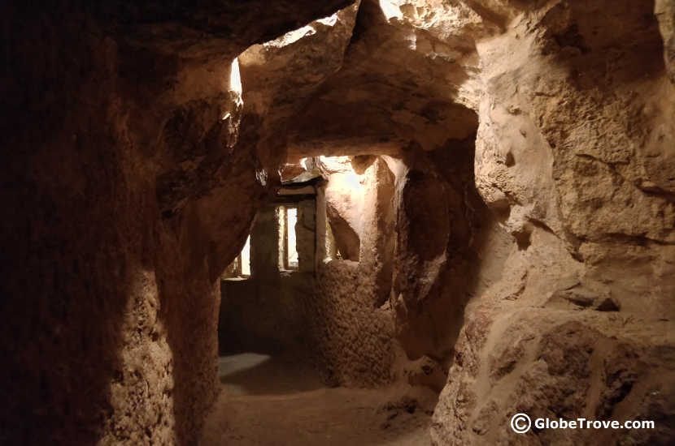
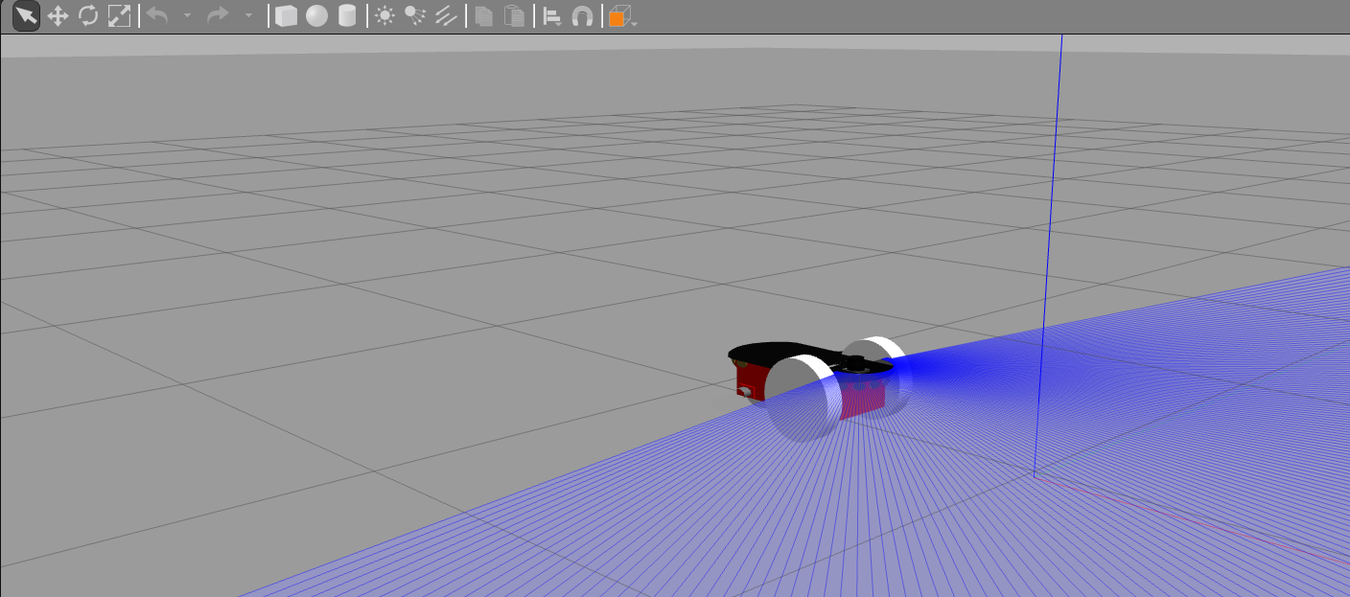
Introduction
Autonomous Rover can explore places where humans cannot
Simulation made lives easier by reducing the implementation costs.
Rover can explore the maze by detecting and avoiding the obstacles and must detect obstacles ahead of it.
Rover will be able to generate its own path and generate a map of the maze.
Sends the data continuously to the receiver and keeps the receiver update about the Map data.
All the functionalities have been implemented in the project

Slide 2

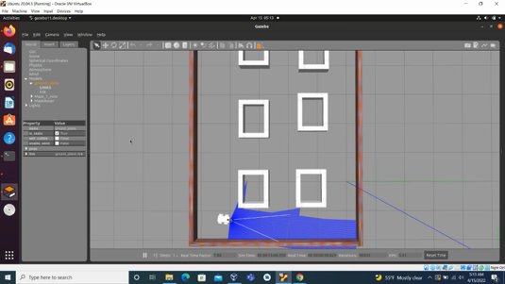
OBSTACLE AVoidance
A lidar sensor is mounted on top of the rover.
The Wall avoidance algorithm allows the rover to avoid the obstacles which are detected by the Lidar sensor.
The Rover avoids collisions with any obstacles in its path and will come out of the maze.

Slide 3

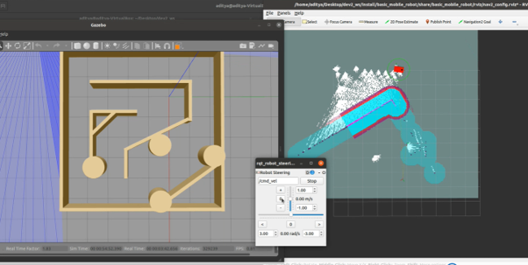
Simultaneous localization and mapping (SLAM)
We have integrated SLAM to the rover.
It provides real time localization and mapping simultaneously.
As the rover moves SLAM generates the map of the path traversed by the rover.
The map data can be seen on the right

Slide 4
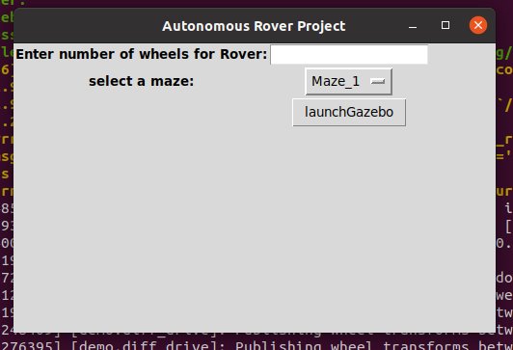
Modularity
If input 2 is given the rover with two wheels and a castor wheel is launched into the gazebo.
If input 4 is given the rover with four wheels is launched into the gazebo.
If input 4 is given the rover with four wheels is launched into the gazebo.
If input 4 is given the rover with four wheels is launched into the gazebo.
It even allows us to select random mazes for the rover from the dropdown

Slide 5
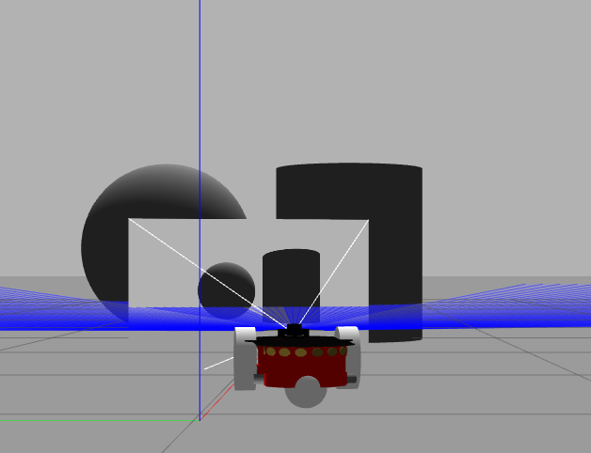
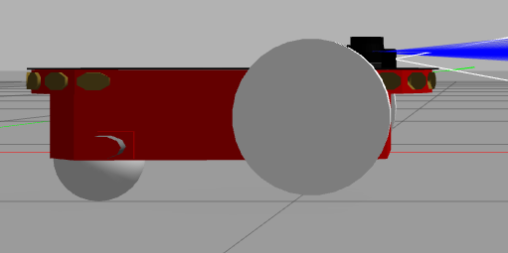
Camera and Mesh
Camera
Have mounted camera on the top of the rover.
The Camera is able to detect any obstacles in its path
Mesh
Have Implemented mesh to the rover .
The mesh improves the structure of rover and gives it an aesthetic look.

Slide 6

CONCLUSION
We were able to make the rover avoid obstacles and successfully traverse the maze.
We have incorporated modularity to our project and the Rover will be generated according to the user input.
We are able to generate map data of the rovers path using SLAM
As a Feature Enhancement we need to implement SLAM on to the existing project to generate map data of maze.

